Slide 1


Fundamentals of Management
Eleventh Edition
Chapter 6
Managing Change and
Innovation
Copyright © 2020, 2017, 2015 Pearson Education, Inc. All Rights Reserved

Slide 2
Learning Objectives
6.1 Define organizational change and compare and contrast views on the change process.
6.2 Explain how to manage resistance to change.
6.3 Describe what managers need to know about employee stress.
6.4 Discuss techniques for stimulating innovation.
6.5 Explain what disruptive innovation is and why managing it is important.

Slide 3
Learning Objective 6.1
Define organizational change and compare and contrast views on the change process.

Slide 4
What Is Organizational Change?
Exhibit 6.1 Categories of Organizational Change
Structure Authority relationships Coordinating mechanisms Job redesign Spans of control
Technology Work processes Work methods Equipment
People Attitudes Expectations Perceptions Behavior

Slide 5
External Forces Create a Need to Change
Marketplace
Government laws and regulations
Technology
Labor markets
Economic changes

Slide 6
Internal Forces Create a Need to Change
Strategy
Composition of workforce
Employee attitudes

Slide 7
Initiating Change
Organizational changes need a catalyst.
Change agent:
  people who act as catalysts and assume responsibility for managing the change process.

Slide 8
Two Different Approaches
“Calm waters” metaphor
“White-water rapids” metaphor

Slide 9
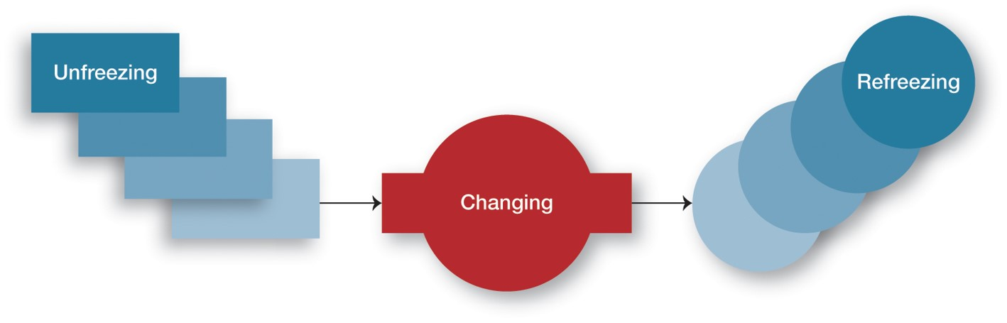
Calm Waters Change
Exhibit 6.2 The Three-Step Change Process

Slide 10
White-Water Rapids Change
Leading a company in change, in an industry in change

Slide 11
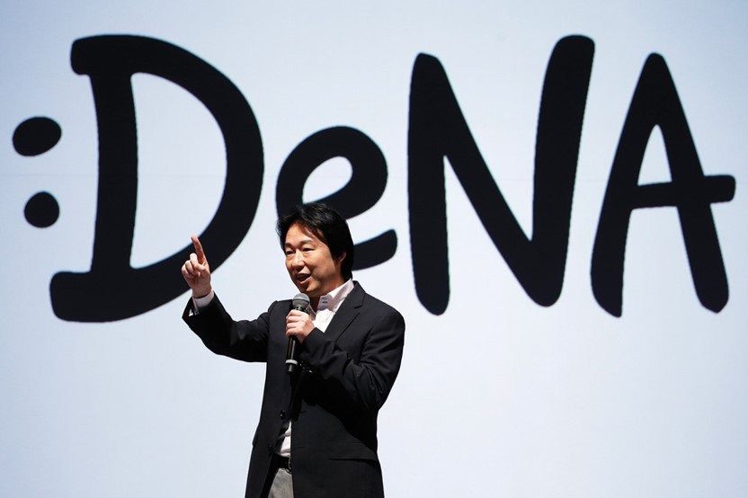
Implementing Change
Organization development (O D):
efforts that assist organizational members with a planned change by focusing on their attitudes and values.

Slide 12
Organization Development Efforts
Survey feedback
Process consultation
Team-building
Intergroup development

Slide 13
Learning Objective 6.2
Explain how to manage resistance to change.

Slide 14
Resistance to Change
Uncertainty
Habit
Concern over personal loss
Belief change is not in organization’s best interests
People resist change even if it might be beneficial! How
about YOU? How do you respond to change?

Slide 15
Reducing Resistance to Change
Exhibit 6.4 Techniques for Reducing Resistance to Change
TECHNIQUE | WHEN USED | ADVANTAGE | DISADVANTAGE
Education and communication | When resistance is due to misinformation | Clear up misunderstandings | May not work when mutual trust and credibility are lacking
Participation | When resisters have the expertise to make a contribution | Increase involvement and acceptance | Time-consuming; has potential for a poor solution
Facilitation and support | When resisters are fearful and anxiety-ridden | Can facilitate needed adjustments | Expensive; no guarantee of success
Negotiation | When resistance comes from a powerful group | Can “buy” commitment | Potentially high cost; opens doors for others to apply pressure too
Manipulation and co-optation | When a powerful group’s endorsement is needed | Inexpensive, easy way to gain support | Can backfire, causing change agent to lose credibility
Coercion | When a powerful group’s endorsement is needed | Inexpensive, easy way to gain support | May be illegal; may undermine change agent’s credibility

Slide 16
Learning Objective 6.3
Describe what managers need to know about employee stress.

Slide 17

Employee Reactions to Change
Change often creates stress for employees!

Slide 18








Change Often Creates Stress for Employees
Employee Stress Levels in Six Major
Country’s Flag | Country | % of Employees
The flag of the United Kingdom | United Kingdom | 35% of employees
The flag of Brazil | Brazil | 34% of employees
The flag of Germany | Germany | 33% of employees
The flag of the United States | United States | 32% of employees
An icon of a globe | GLOBAL AVERAGE | 29% of employees
The flag of China | China | 17% of employees
The flag of India | India | 17% of employees

Slide 19
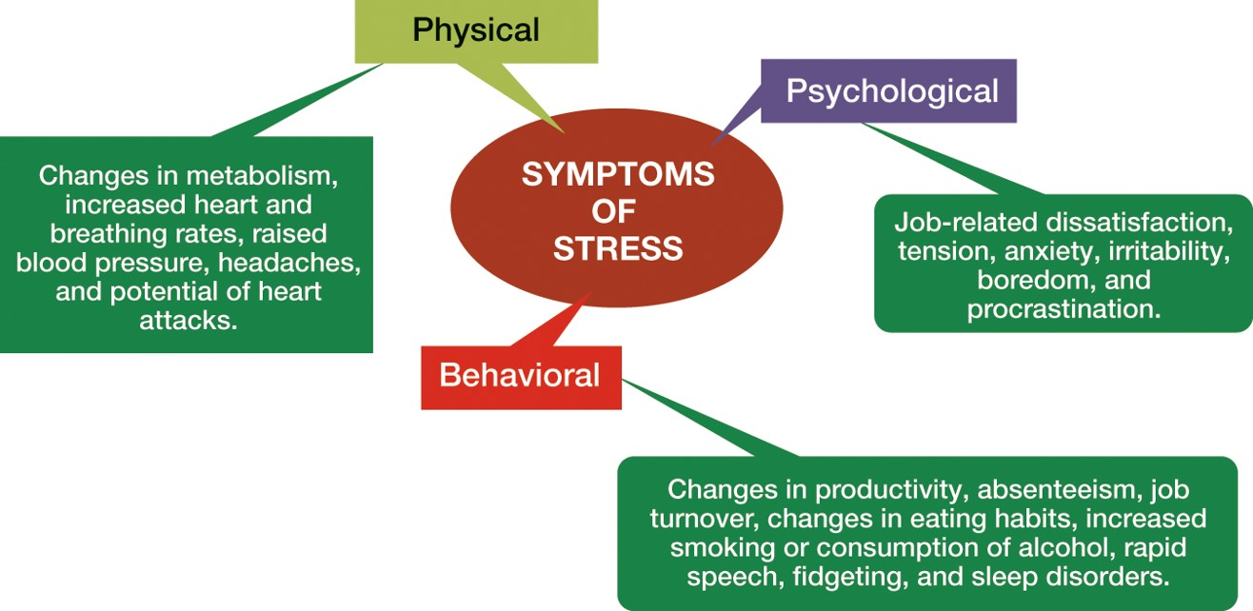
Symptoms of Stress
Exhibit 6.3 Symptoms of Stress

Slide 20
Causes of Stress: Job Related
Task demands
Role demands
  Role conflicts
  Role overload
  Role ambiguity
Interpersonal demands
Organization structure
Organizational leadership

Slide 21

Causes of Stress: Personal
Family and personal issues
Personality type

Slide 22
Reducing Stress
STRESS MANAGEMENT

Slide 23
Learning Objective 6.4
Discuss techniques for stimulating innovation.

Slide 24
Creativity and Innovation
Creativity:
the ability to produce novel and useful ideas.
Innovation:
the process of taking a creative idea and turning it into a useful product, service, or method of operation.
“Innovation is the key to continued success.”
“We innovate today to secure the future.”

Slide 25

Innovation Process
“Innovation is the key to continued success.”
“We innovate today to secure the future.”
Perception
Incubation
Inspiration
Innovation

Slide 26
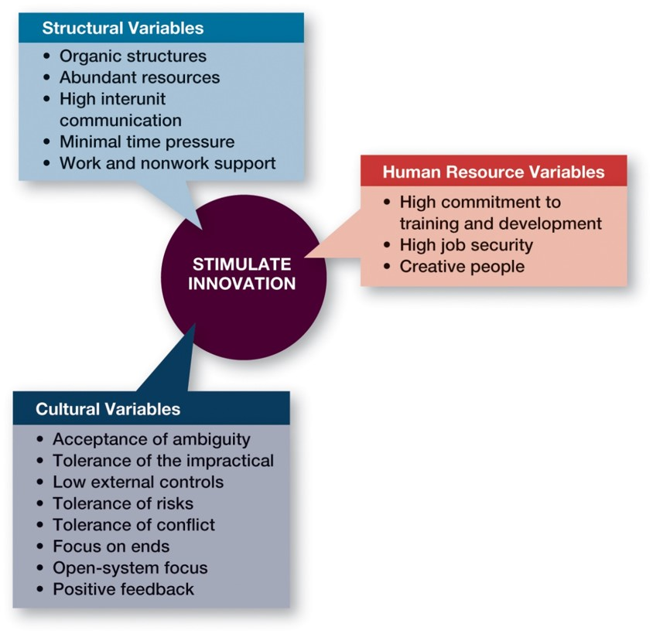
Encouraging Innovation
Exhibit 6.5 Innovation Variables

Slide 27
Structural Variables and Innovation
Organic structures
Abundant resources
High interunit communication
Minimal time pressure
Work and non work support

Slide 28
Culture and Innovation
Acceptance of ambiguity
Tolerance of the impractical
Low external controls
Tolerance of risks
Tolerance of conflict
Focus on ends
Open-system focus
Positive feedback

Slide 29

H R and Innovation
Idea champion:
individuals who actively and enthusiastically support new ideas, build support for, overcome resistance to, and ensure that innovations are implemented.

Slide 30
Learning Objective 6.5
Explain what disruptive innovation is and why managing it is important.

Slide 31
Managing Disruptive Innovation
Disruptive innovation:
innovation in products, services, or processes that radically change an industry’s rules of the game.
Sustaining innovation:
innovations that represent small and incremental changes in established products rather than dramatic breakthroughs.

Slide 32
Examples of Past Disruptive Innovations (1 of 2)
Exhibit 6.6 Examples of Past Disruptive Innovators
Established Business | Disruptor
Compact disc | Apple i Tunes
Carbon paper | Xerox copy machine
Canvas tennis shoes | Nike athletic shoes
Portable radio | Sony Walkman
Sony Walkman | Apple i Pod
Typewriters | I B M P C
Weekly news magazines | C N N
T V networks | Cable and Netflix
Local travel agencies | Expedia
Stockbrokers | e Trade
Traveler’s checks | A T M s and Visa

Slide 33
Examples of Past Disruptive Innovations (2 of 2)
Exhibit 6.6 Examples of Past Disruptive Innovators (continued)
Established Business | Disruptor
Encyclopedias | Wikipedia
Newspaper classified ads | Craig’s List
A M/F M radio stations | Sirius X M
Tax preparation services | Intuit’s Turbo Tax
Yellow Pages | Google
Paper maps | Garmin’s G P S
Paperback books | Kindle
Lawyers | Legal Zoom
Taxis | Uber

Slide 34

Why Is Disruptive Innovation Important?
Skunk works:
a small group within a large organization, given a high degree of autonomy and unhampered by corporate bureaucracy, whose mission is to develop a project primarily for the purpose of radical innovation.
47 percent of business leaders say that finding and keeping employees to counteract disruptive change is a significant

Slide 35
Advice In A Disruptive World
Never get comfortable with a single employer.
Keep your skills current.
Remember that YOU are responsible for your future.
Take risks while you’re young.

Slide 36

Copyright
This work is protected by United States copyright laws and is provided solely for the use of instructors in teaching their courses and assessing student learning. Dissemination or sale of any part of this work (including on the World Wide Web) will destroy the integrity of the work and is not permitted. The work and materials from it should never be made available to students except by instructors using the accompanying text in their classes. All recipients of this work are expected to abide by these restrictions and to honor the intended pedagogical purposes and the needs of other instructors who rely on these materials.

